Slide 1


Slide 2


Special thanks
to our sponsors St Vincent’s Hospital

Slide 3
Learning Objectives
At the end of this webinar, participants will understand
how to optimise investigation and workup of the suspected breast cancer patient
the complexities of breast cancer management with multimodal treatments.
the changing management of the axilla and the aims of axillary staging.
the limitations of hormone therapy due to hormone deprivation symptoms
the timing and appropriateness of breast reconstruction in certain situations which is highly individualised and dependent on other therapies.
the common side effects of chest wall/breast radiotherapy
the management of acute radiation skin reactions

Slide 4
Case 1 – 49 year old female
First presented December 2019 with lump but imaging NAD
Felt larger lump with progressive skin changes and mass increased in size
Systemically well
On examination – peau d’orange of left breast
- palpable axillary lymph node
Notes:
Social History
Lives with partner
Non-smoker
Alcohol – half a bottle of wine per night
Hospitality worker
Supportive family and friends

Slide 5
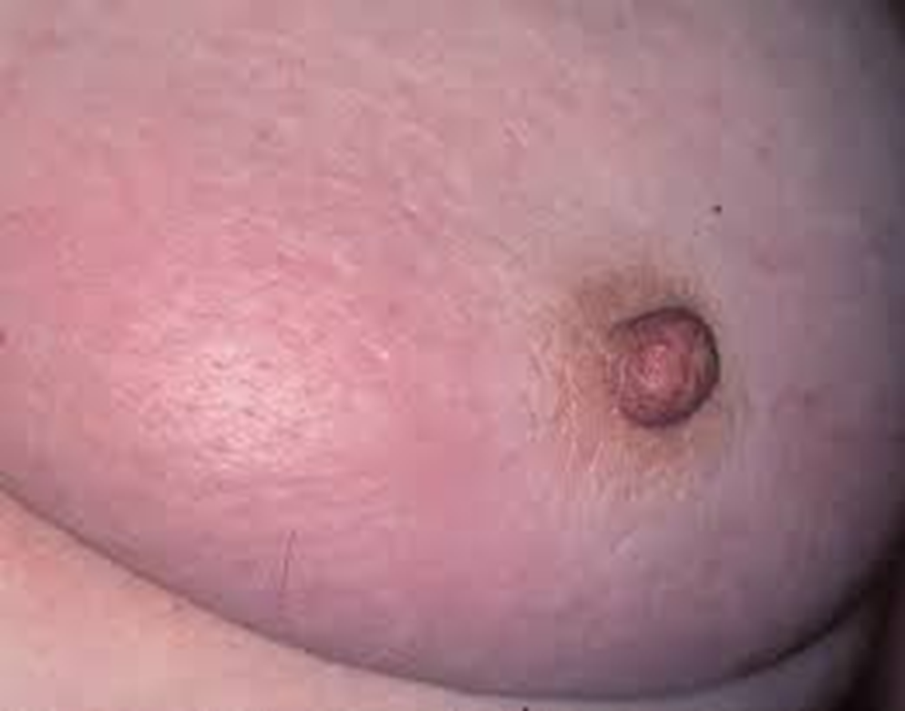

Slide 6
Case 1 – Medical history
Hyperlipidaemia - ?familial
Recent NSTEMI - had an angiogram and TTE – medical management
Notes:
Cholesterol = 9.5
Angiogram (GCUH) Jan 2020 – mild stenosis, patient reported
Echocardiogram Jan 2020 – no regional wall abnormality, EF 70%
Cardiology follow up arranged

Slide 7
Case 1 – Family history
Mother – breast cancer at age 70
Grandmother, maternal – breast and ovarian cancer
Maternal aunt – breast cancer at age 37
Sister – breast cancer age 44 - undefined variant of BRCA
Notes:
Likely BRCA - need to consider mastectomies and BSO

Slide 8
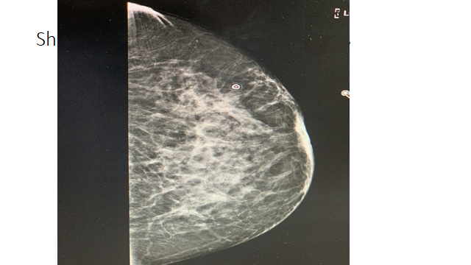
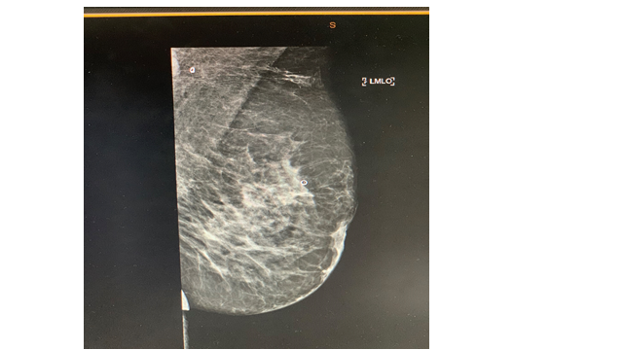

Slide 9
Case 1 - Results
Needle biopsy 11/2/20 - Infiltrating carcinoma
- ER+ve/PR-ve/HER2-ve
Left axillary lymph node biopsy – carcinoma
PET Scan – no evidence of distant metastases

Slide 10
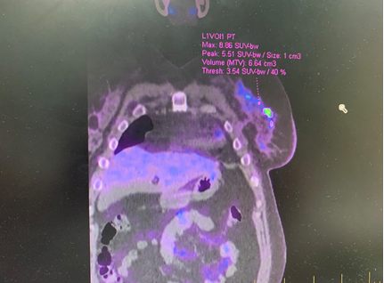

Slide 11
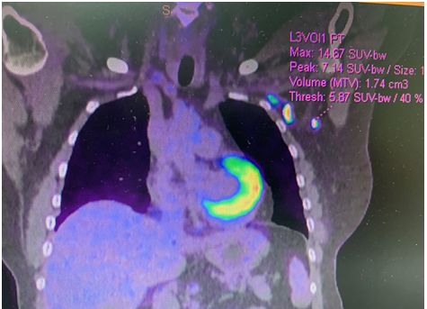

Slide 12
Case 1 - Medical Oncology Consult
Recommended neoadjuvant chemotherapy
Surgeons perspective - “value adding”
Advantages
Disadvantages

Slide 13
Case 1 – Neoadjuvant Chemotherapy
Pros | Cons
Improve chance of breast conserving surgery | No survival benefit
Locally advanced/borderline inoperable may reduce tumour size and improve local control following radiation. | Anxiety if don’t have a response
More likely to shrink if it is triple negative or hormone receptor negative/ HER2 positive | 3% chance of cancer growing – ie not then operable
May not need an axillary dissection
Check the response to chemotherapy
Notes:
Reduce tumour size
25% will avoid an mastectomy
Disease specific and overall survival was identical in the two groups.
A clinical response rate of 80% was seen with 13% complete pathological response.
Fewer mastectomies (60% versus 67%, p=0.002) performed in patients undergoing preoperative chemotherapy.

Slide 14

The number of patients with no visible cancer.
Notes:
better the response most likely less likelihood of recurrance

Slide 15
Case 1 – Response to treatment
Completed 4 cycles of AC and then 12 weeks of paclitaxel
Clinically good response
Then bilateral mastectomy
Histopathology – still residual disease
- 100mm ILC (invasive lobular cancer), clear margins, minimal treatment effect
- Grade 2, skin not involved, lymphovascular invasion
- 8/9 nodes involved

Slide 16
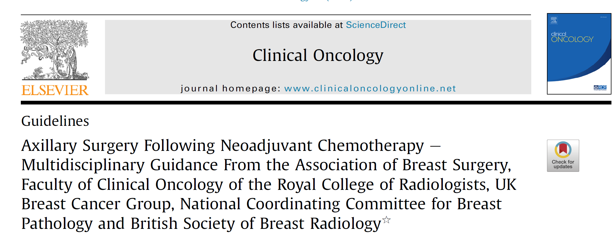
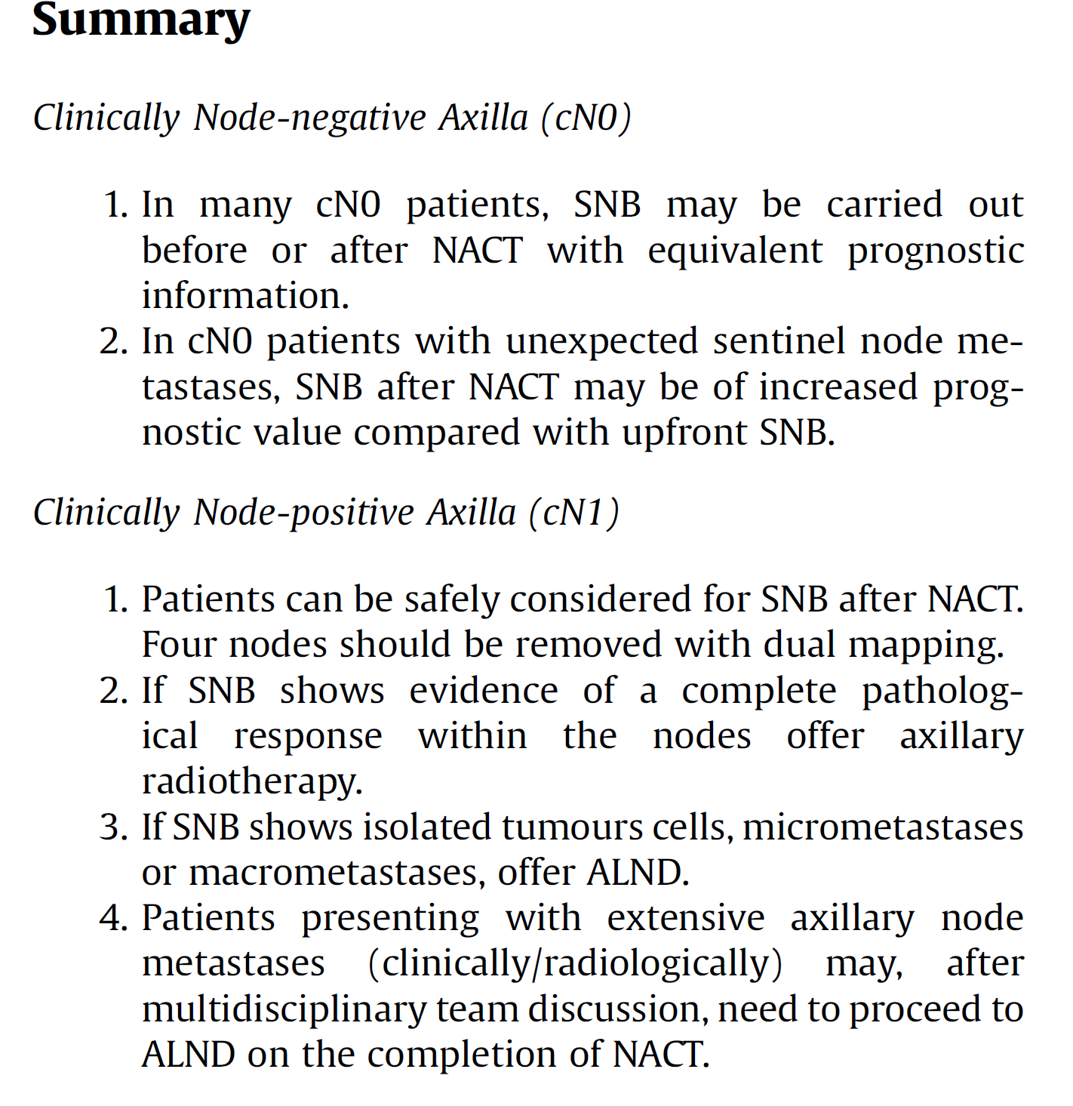
Case 1 – Guidelines
Notes:
???? rob to talk about reconstruction options here

Slide 17
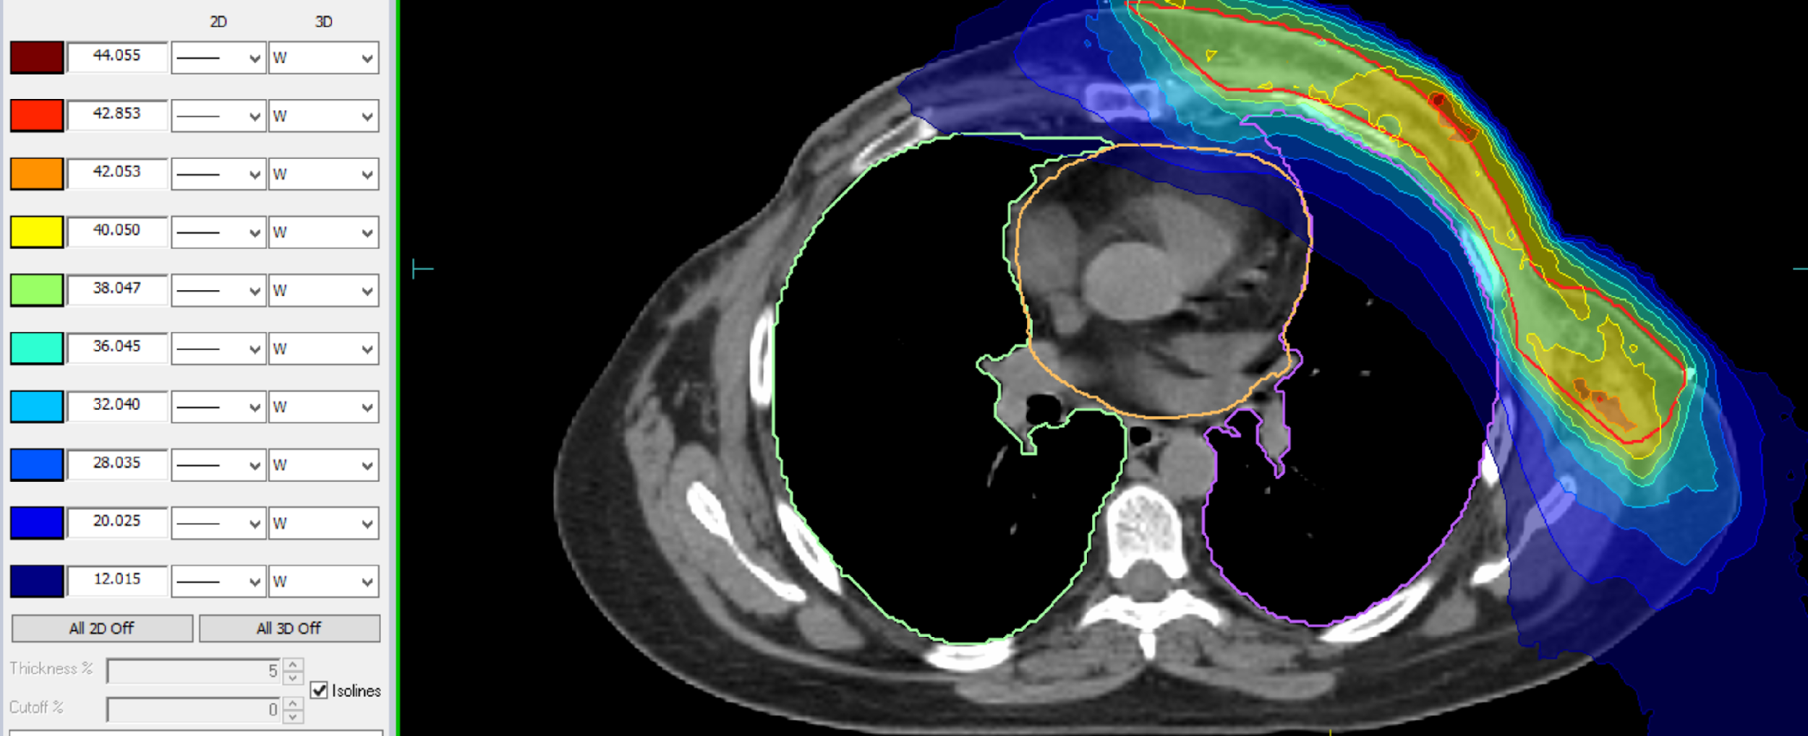
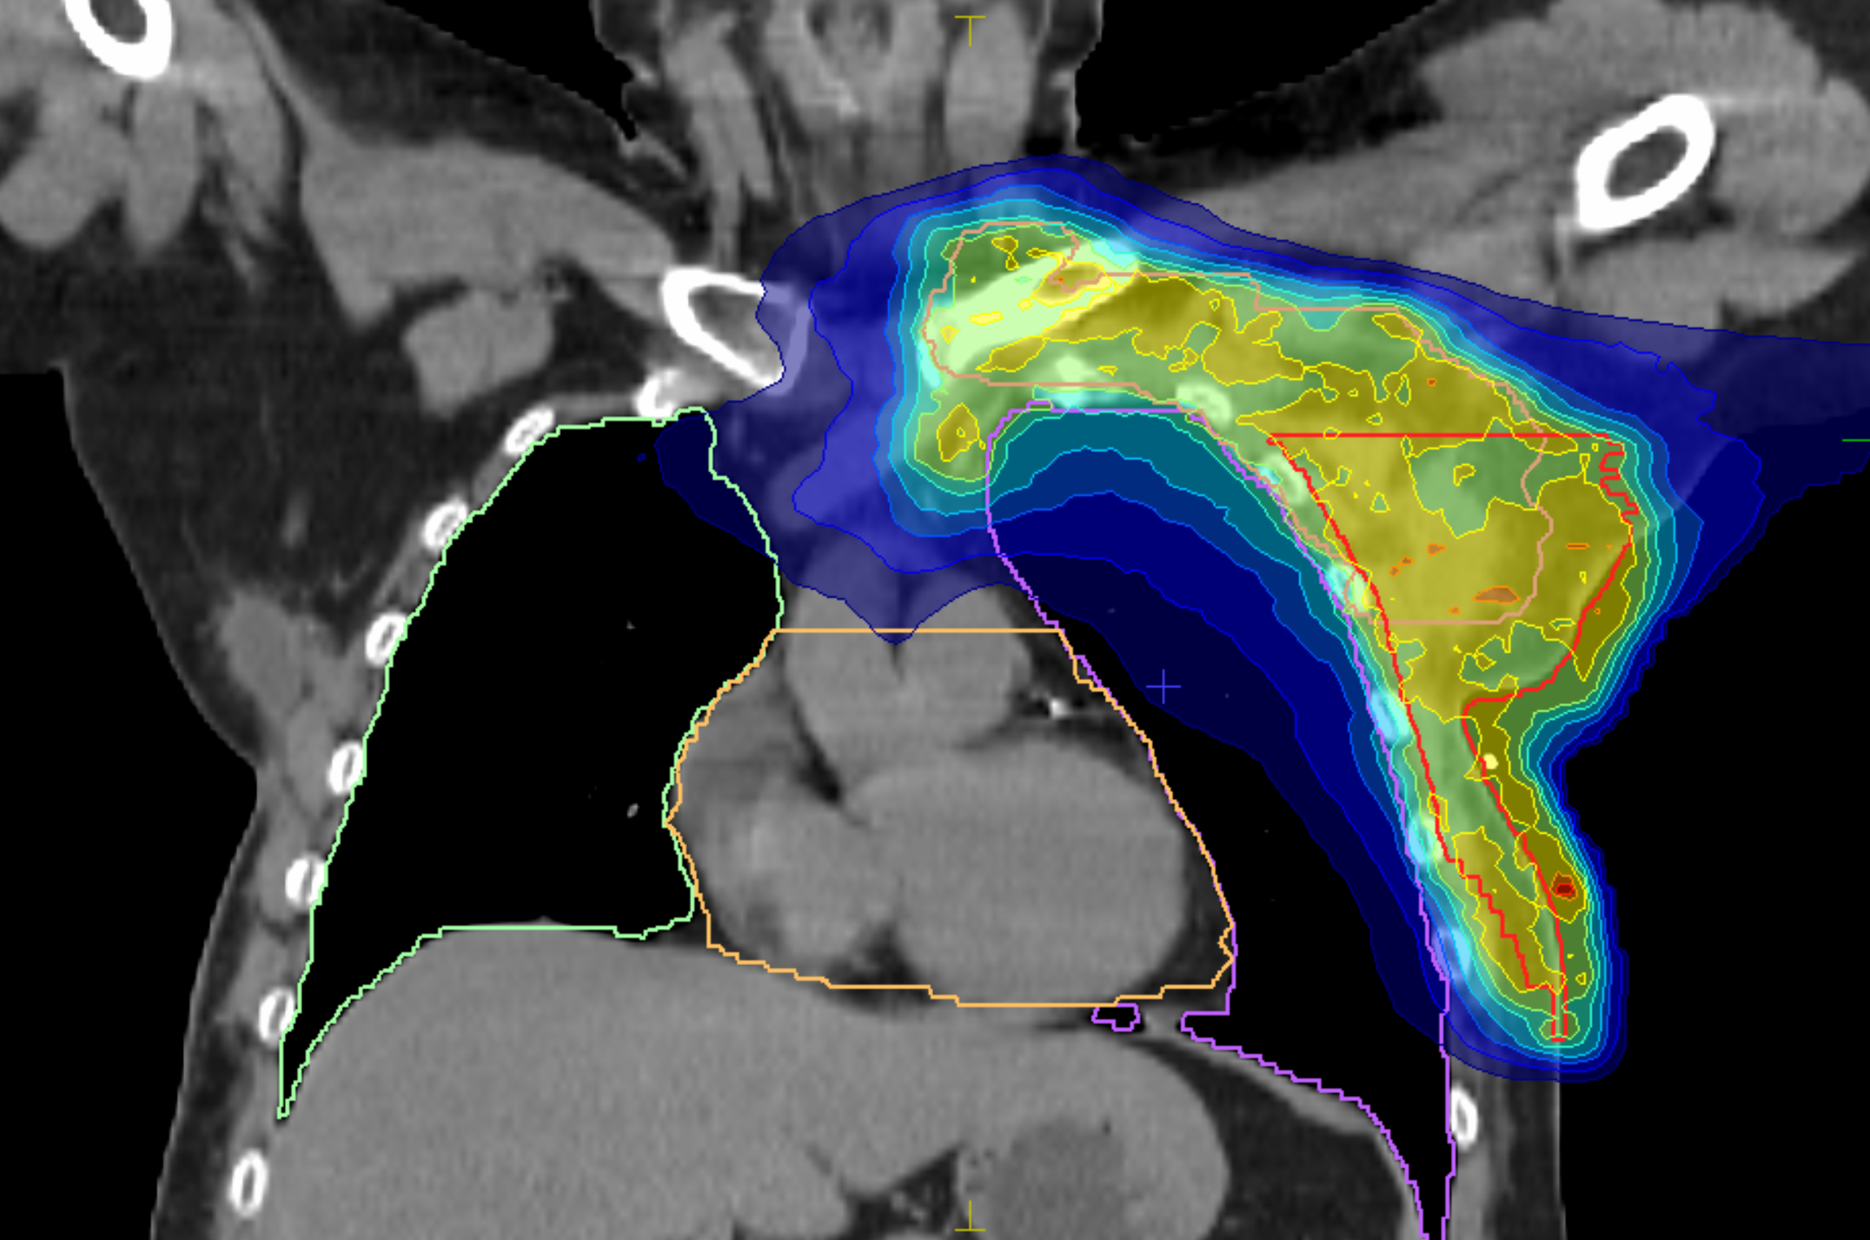
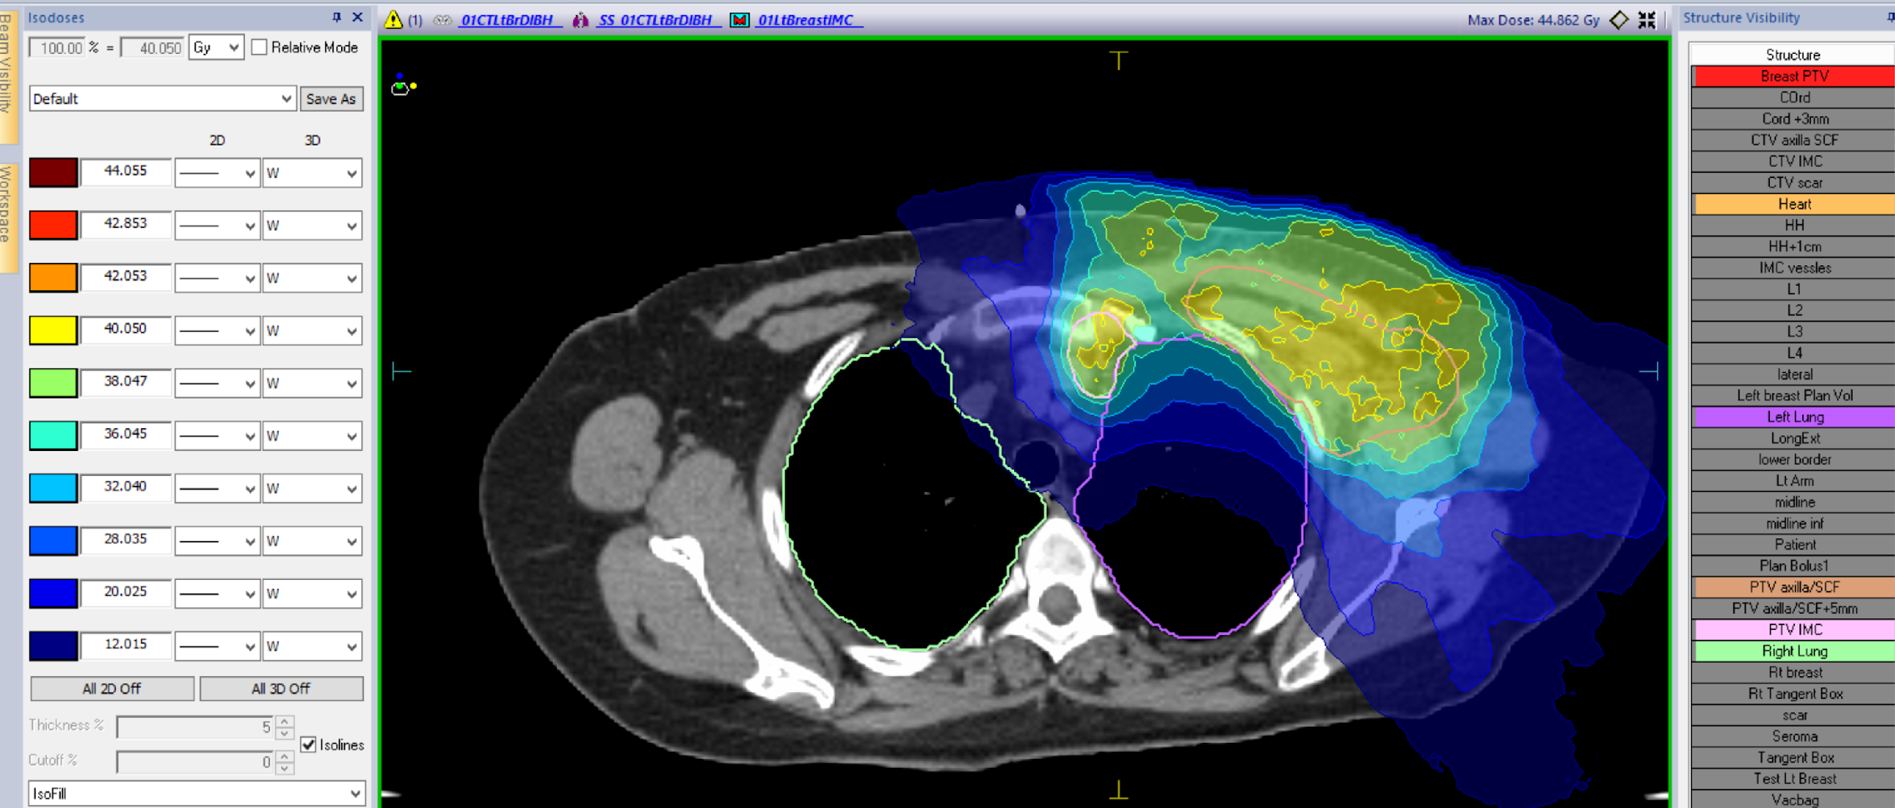
Case 1 – Radiotherapy
Adjuvant radiotherapy to chest wall/ axilla/ supraclavicular fossa/ internal mammary chain
(VMAT technique – volumetric arc therapy)
Notes:
Pt will then need to go on hormonal therapy – an AI

Slide 18
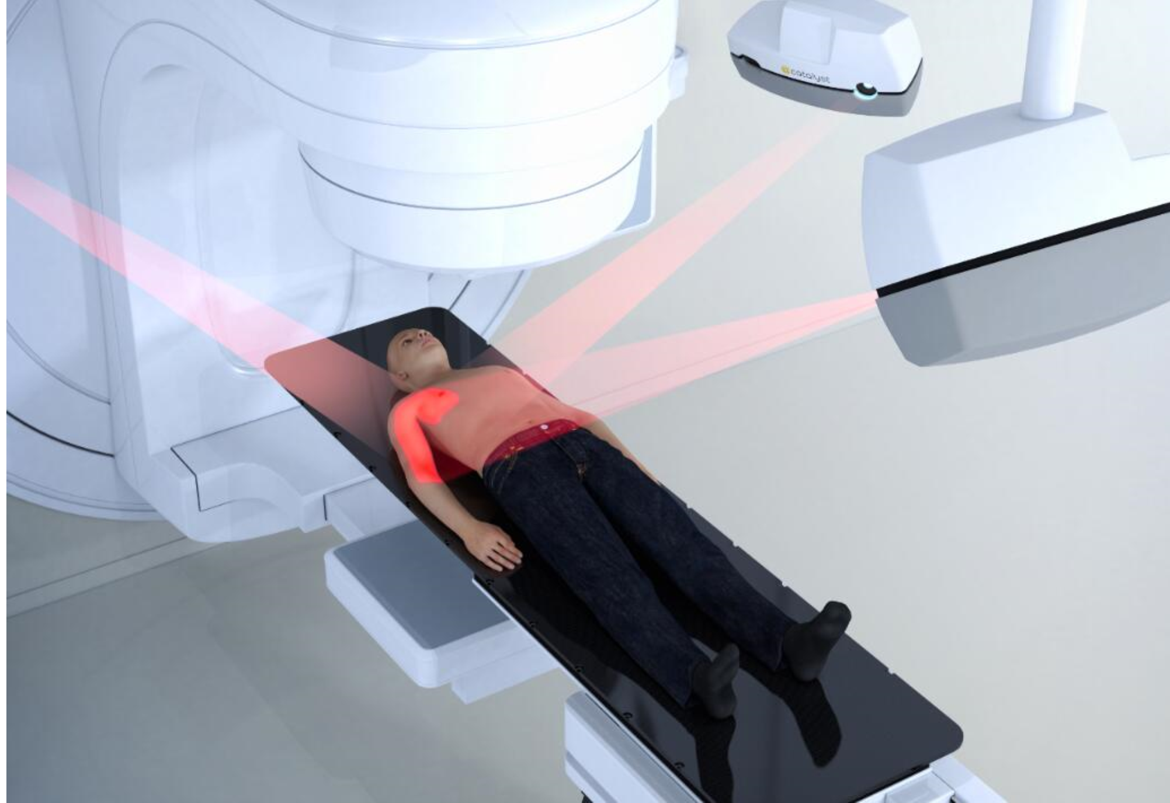
Case 1 – DIBH (Deep Inspirational Breath Holding) with surface guided radiotherapy

Slide 19
Case 1 – Radiation skin reaction on breast cancer patients
Early effect
Erythema >> dry desquamation >> wet desquamation >> ulcers
Pruritus- radiation induced folliculitis
Late effect
Fibrosis
Telangiectasia
Dry skin

Slide 20
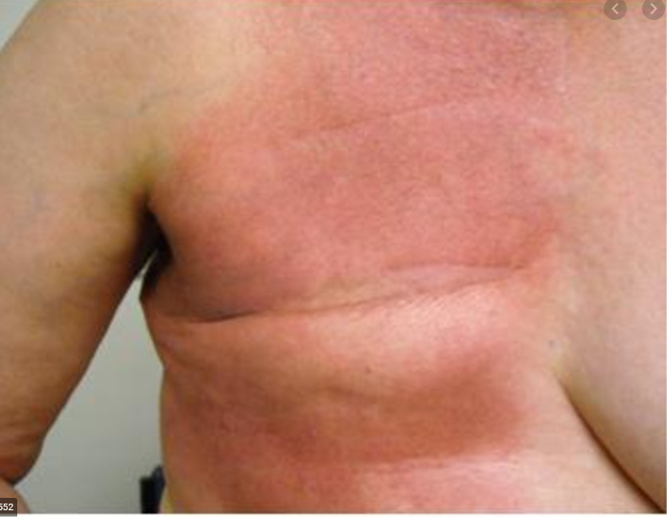
Case 1 – Management of radiation skin reactions
Prevention/Minimization during RT
Moisturizers- Sorbolene, Moogoo, Alovera
Avoid irritants
Mepitel film on chest wall
Early identification and treatment of infection
Folliculitis- Lignocaine, topical steroids
Post RT
Wound care
Zinc / Castor oil

Slide 21
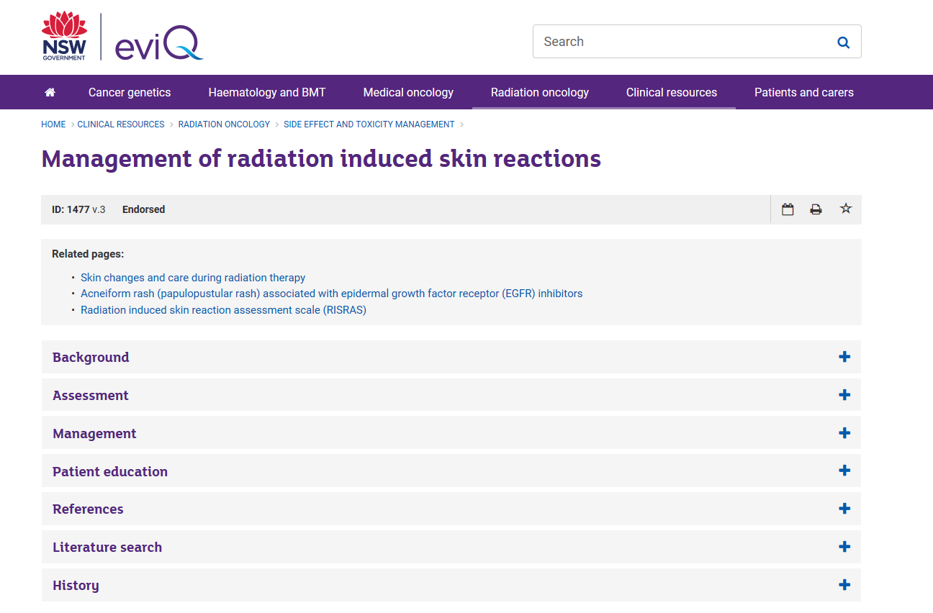
Useful resource

Slide 22


Slide 23
Case 2 – 36 year old female
No comorbidities
Planning to start a family
Noticed right nipple inversion
Ultrasound suspicious lesion 1 cm from the nipple at the 9 o’clock
Biopsy confirmed an invasive ductal carcinoma.
WLE + sentinel node biopsy: 16mm Grade 2 invasive ductal carcinoma with clear margins, no lymphovascular invasion, KI 67 of 10%, ER positive, PR negative, HER2 negative and no lymph nodes involved.

Slide 24
Case 2 – Options
Medical Oncology – intermediate risk tumour
What are the options?
What else needs to be considered?
Notes:
Gene signature assay
Chemo
Hormones – inc zoladex
Just hormones
Fertility

Slide 25
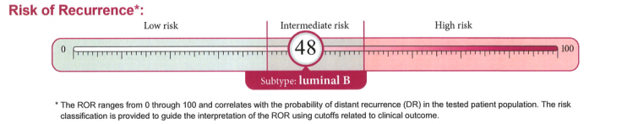
Case 2 Prosigna – gene signature assay
Gene expression assays
Tests the activity of 58 genes in a sample of tumour tissue
The pattern of gene activity in breast cancer can provide information about the risk of recurrence and likely response to chemotherapy of a breast cancer.
Costs $2900

Slide 26
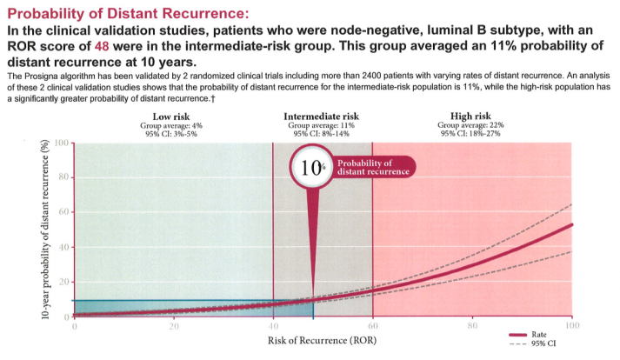
Case 2 – Probability of distant recurrence
Notes:
TailorX study – 21 gene assay. Adjuvant endocrine therapy and chemoendocrine therapy had similar efficacy in women with hormone-receptor–positive, HER2-negative, axillary node–negative breast cancer who had a midrange 21-gene recurrence score, although some benefit of chemotherapy was found in some women 50 years of age or younger.

Slide 27
Case 2 – Zoladex (goserelin) – LHRH agonist
Ovarian suppression - reduce the risk of recurrence and mortality in pre-menopausal women with hormone receptor positive early breast cancer.
The results of the SOFT and TEXT trials showed that recurrence is significantly reduced in patients treated with exemestane plus an LHRH agonist compared with those treated with tamoxifen plus an LHRH.
Treatment length - ? 2 years
Amenorrhoea occurred in more than 95% of goserelin patients by 6 months versus 58.6% of patients on chemo
Menses returned in most goserelin patients after therapy stopped. Whereas amenorrhoea was generally permanent in chemo patients (22.6% v 76.9% amenorrhoeic at 3 years)

Slide 28
Case 2 – Fertility Preservation Options
Goserelin – reducing activity in the ovaries may protect eggs from being damaged
- only 257 patients in the study but compared standard chemo +/- Goserelin
The primary study end point was the rate of ovarian failure at 2 years, with ovarian failure defined as the absence of menses in the preceding 6 months and levels of follicle-stimulating hormone (FSH) in the postmenopausal range.
Results: the ovarian failure rate was 8% in the goserelin group and 22% in the chemotherapy-alone group (two-sided P=0.04)
Pregnancy occurred in more women in the Goserelin group than in the chemotherapy-alone group (21% vs. 11%, P=0.03)
Women in the goserelin group also had improved disease-free survival (P=0.04) and overall survival (P=0.05).
Notes:
gonadotropin-releasing hormone (GnRH) is a long-acting hormone used to cause temporary menopause
NB 40% loss of follow up!!

Slide 29
Case 2 – Other options
• Egg/Embryo Freezing – part of IVF, takes 2-3 weeks
- but need hormones!!!!
• Ovarian cryopreservation – still experimental and expensive
Notes:
IVF - ?need ovarian stimulation
Ovarian tissue freezing involves freezing and storage of tissue from the ovarian cortex.

Slide 30
Case 2 - Tolerance of hormone deprivation
Completion of therapy
Change of therapy
Inadequate treatment if chemotherapy omitted as well
Local recurrence if radiotherapy declined as well
Notes:
this case - zoladex and exemestane
radiation - pros and cons

Slide 31
Case 2 – Management of hormone side effects
• Hot flushes – environment
- diet
- venlafaxine
- gabapentin/pregabalin
- clonidine
- acupuncture
• Mood changes – Efexor
- ?lower dose
• Arthralgias – change to another AI
- change to tamoxifen

Slide 33
Case 3 – Elderly patient with symptomatic disease
92 years old
Mild dementia, valvular heart disease (moderate aortic stenosis) – on Plavix
Mild CRF
Pacemaker
Prevous CVA – balance issues
Lump kept hidden from family

Slide 34
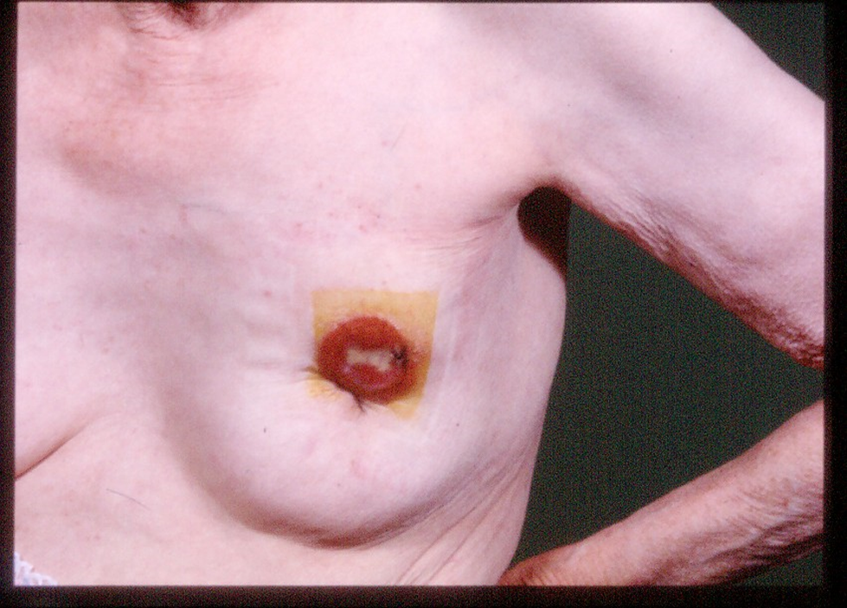

Slide 35
Case 3 – Optimal Treatment for the Individual
Additional information about circumstances
Family conference
Biopsy results
Anaesthetic review ?
Notes:
importance of gp at MDT

Slide 36
Case 3 – Treatment Options
Conservative
Medication
Radiotherapy
Surgery ?

Slide 37
Case 3 – Pathology of Biopsy
Invasive ductal cancer
Oestrogen and progesterone receptor negative, HER-2 positive
New set of limited options to consider

Slide 38
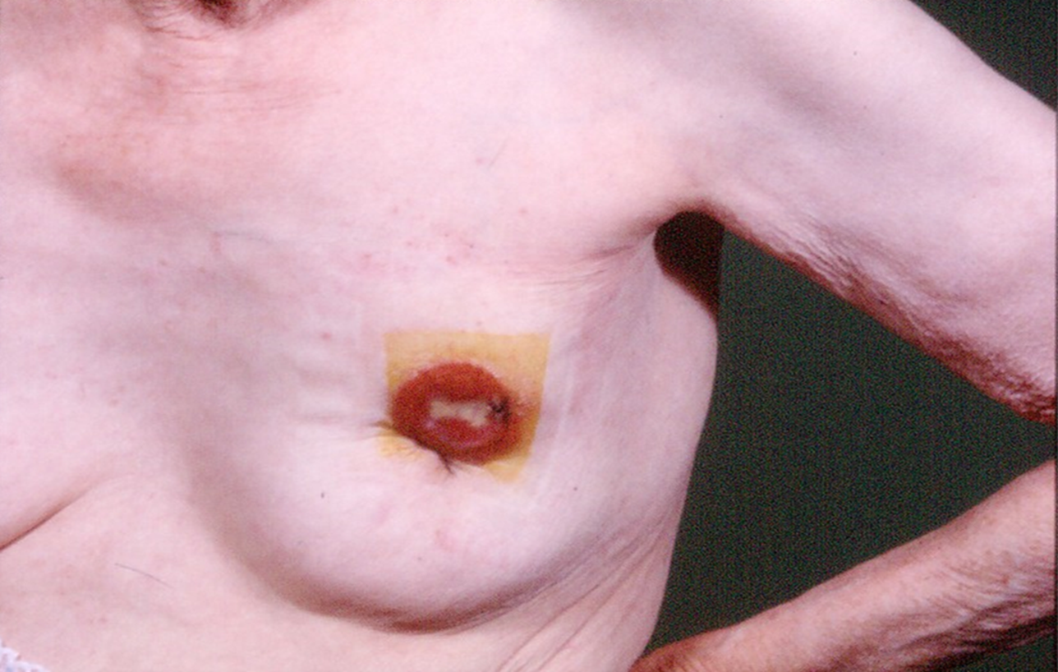

Slide 39
Case 3 – Surgical Pathology Result
61mm ulcerated tumour
1 macro metastasis in 7 nodes examined
Clear margins
Same hormone profile as biopsy

Slide 41

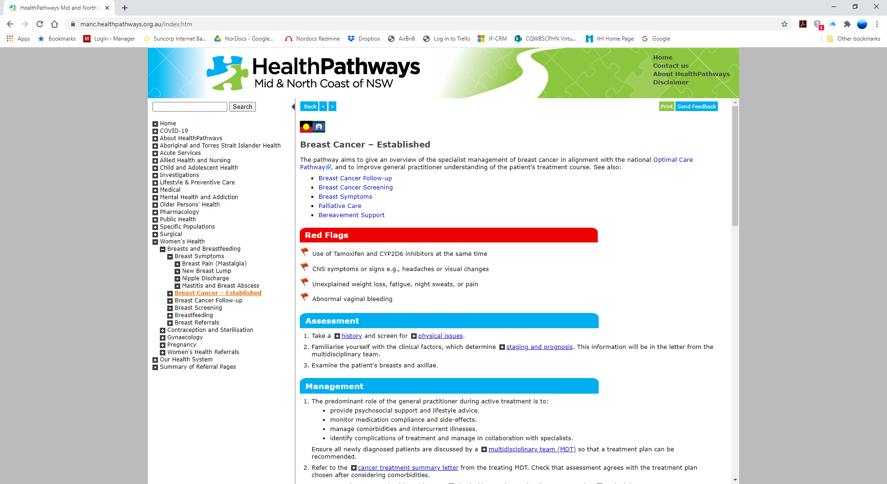
manc.healthpathways.org.au
​Username: manchealth​
Password: conn3ct3d​

Slide 42


Slide 43
References
Fisher, B., A. Brown, E. Mamounas, et al. 1997. "Effect of preoperative chemotherapy on local-regional disease in women with operable breast cancer: findings from NSABBP B-18." J.Clin Oncol. 15(7):2483-2493.
Dieras, V., P. Fumoleau, G. Romieu, et al. 2004. "Randomized parallel study of doxorubicin plus paclitaxel and doxorubicin plus cyclophosphamide as neoadjuvant treatment of patients with breast cancer." J.Clin Oncol 22(24):4958-4965.
Dieras, V., P. Fumoleau, G. Romieu, et al. 2004. "Randomized parallel study of doxorubicin plus paclitaxel and doxorubicin plus cyclophosphamide as neoadjuvant treatment of patients with breast cancer." J.Clin Oncol 22(24):4958-4965

Slide 44
References
4. Cuzick, J, L Ambroisine, N Davidson, et al. 2007. "Use of luteinising-hormone-releasing hormone agonists as adjuvant treatment in premenopausal patients with hormone-receptor-positive breast cancer: a meta-analysis of individual patient data from randomised adjuvant trials." Lancet 369(9574):1711-1723.
5. Pagani, O., M. M. Regan, B. A. Walley, et al. 2014. "Adjuvant exemestane with ovarian suppression in premenopausal breast cancer." N Engl J Med 371(2):107-118.
6.Halle C.F. Moore, M.D., Joseph M. Unger, Ph.D, et al. 2015 Goserelin for Ovarian Protection during Breast-Cancer Adjuvant Chemotherapy. N Engl J Med 2015; 372:923-932

